Slide 1

Bakersvilla An online bakery management system
A Project by :
Dubey Anant Jitendra
Gangurde Sukrut Sunil
Gaikwad Punam Himmatrao
Deore Harshada Vinaykumar

Slide 2

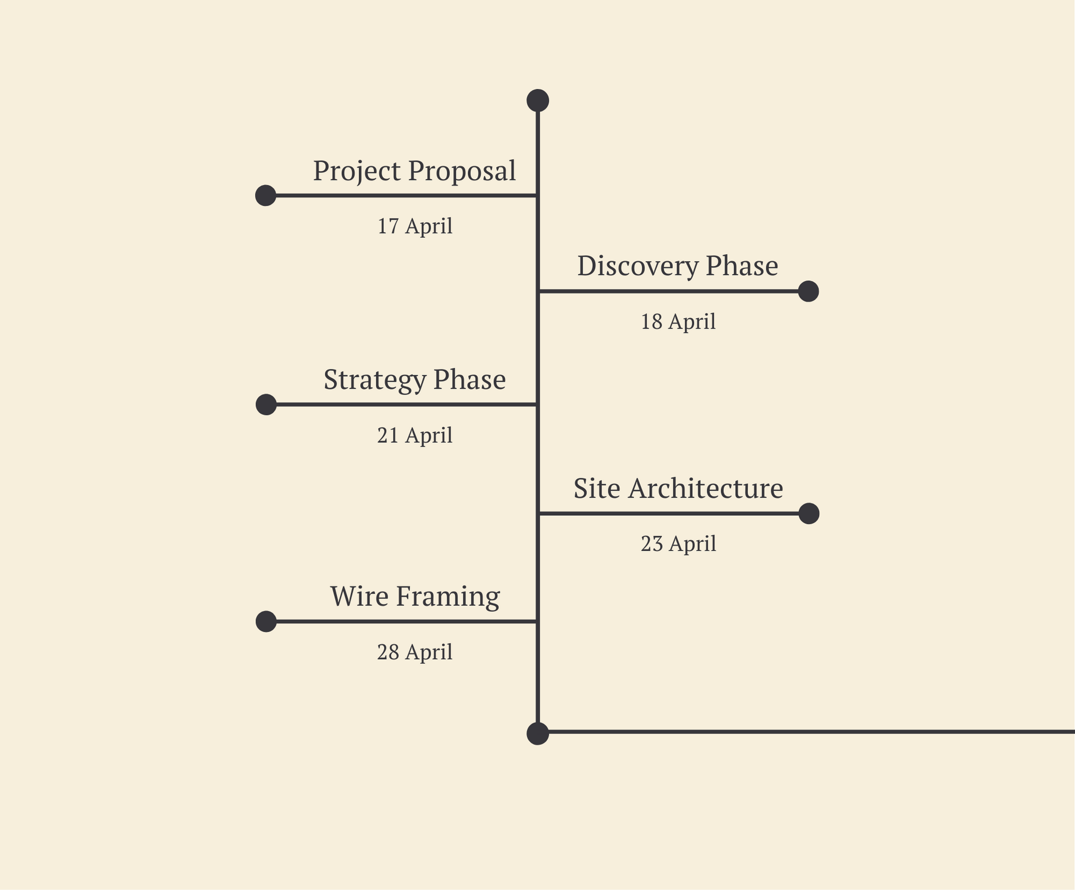
Project Timeline
Project Proposal
Meeting with Project guide
Prof. B. B. Darekar and discussion of project idea.
Discovery Phase
Discussion about why Online Bakery System is needed.
Strategy Phase
Discussion and planning about how to build an efficient online website.
Site Architecture
Discussion about what is needed to build an online site and learning the tools needed to build a website.
Wire Framing
Planning the user flow and making basic structure of the website.

Slide 3
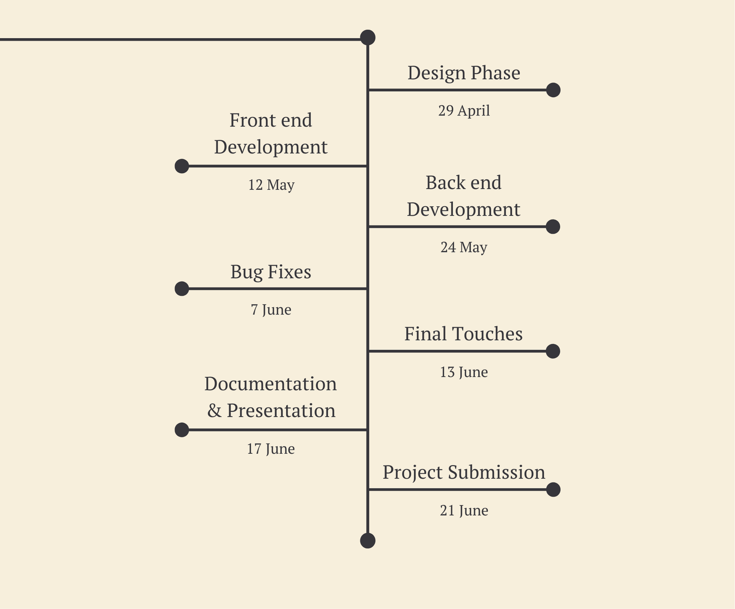
Design Phase
Making a design about how the website should look.
Front end Development
Developing front end with the help of HTML, CSS and PHP.
Back end Development
Developing back end with the help of PHP, JS and SQL.
Bug Fixes
Testing website and fixing bugs.
Final Touches
Improving the website as needed.
Documentation & Presentation
Making of final draft of documentation and making of presentation.
Project Submission
Final project submission to the college.

Slide 4
Introduction
Online shopping is becoming trend nowadays. People like online shopping compared to the traditional way to save their money and time.
BakersVilla is an online bakery ordering system where various types of cakes are the main product to sell online.
This allows customer to check for different bakery items available at the online shop and then purchase online. The project provides a list of bakery products displayed online in various categories. The user may browse through these items. If the user wants to purchase any product(s), he/she may add it to his shopping cart.
It provides customers online shopping facilities from their homes. Usually, the customer will be asked to fill a very short and simple form containing information about shipping address and other details, etc.
A customer can sign up for free, log in to his / her account can browse items of his / her own interest, and can view prices and other details of selected items.
This website project will be developed using PHP as the front end and SQL Server as a back-end.

Slide 5
Problem Statement
Customers visits Bakery shops physically which requires an ample amount of time which increase hassle which is faced by customers as well as staff of the bakery and reduces the efficiency of the sales.
Shopkeeper has to invest a large amount of money to build a bakery before they can start selling.
Manually managing bakery is difficult and requires a lot of skill.
Online bakery solves that problem for everyone who has a device which supports a web browser and have an internet connection.
As online websites and systems are getting an increase in popularity in this modern era the shopkeeper and customer will find it much easier and relaxing to use this system.

Slide 6
Drawbacks of Existing System
Keeping record of all customers is a very tedious job.
Searching a particular record is tedious because it involved searching all entries which requires more time.
Manual system is difficult and time consuming.
Human errors are more.
Requires skill and capital to start a Bakery.

Slide 7
Proposed System
This system provides an interactive interface through which a user can interact with different areas of application easily.
Authorization system of an online system is one of important feature without an effective authorization mechanism.
Searching products is more convenient.
System will maintain the information of customer such as customer Id, customer name, Email.
System will maintain the information of products such as product details, product price, and quantity.
System provides an interface to shopkeeper to sell his products without an extra cost.
Current records can be matched with the previous records which improves management of records.
When searching a product, customer can always search for the best deal available thus benefitting customer.

Slide 8
Hardware & Software Requirements
Processor : Intel i3 8th Gen or Ryzen 3
RAM : 4 GB or more
Storage : No storage is required as this is an online website
Operating System : Windows, Linux, Mac OS, etc.

Slide 9
Tools Used
Languages :
PostgreSQL
PHP
HTML
CSS
JS
Software :
VS Code
Chrome
Git & Github

Slide 10
System Modules
User Registration : User can register on the system and get his online account on site.
User Login : User can login to system and check various bakery items.
Product Categories : The bakery products are arranged and can be viewed in categories.
Add to cart : Users can add new items to cart.
Feedback : Users can give feedback to shop owners and admin.

Slide 11
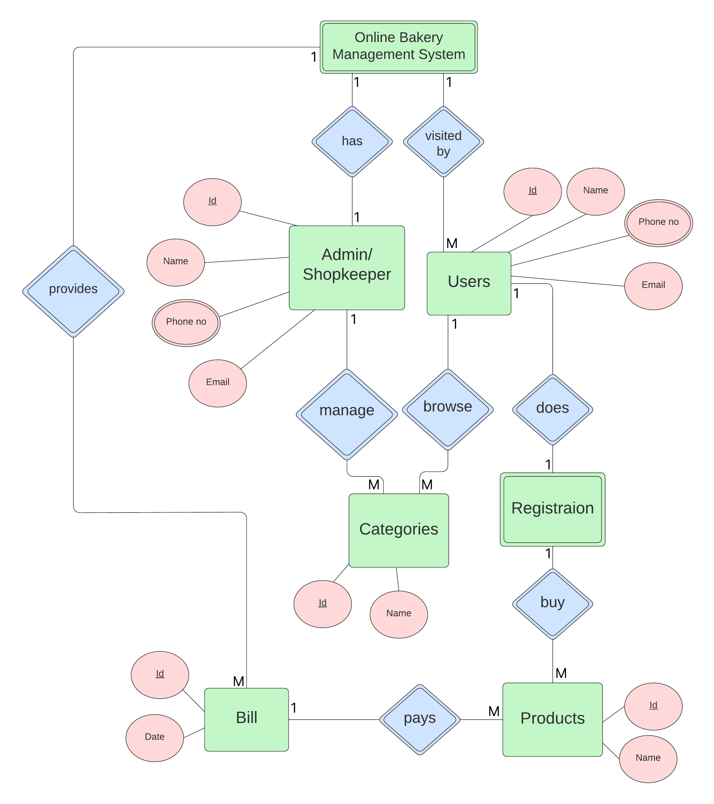
E-R Diagram

Slide 12
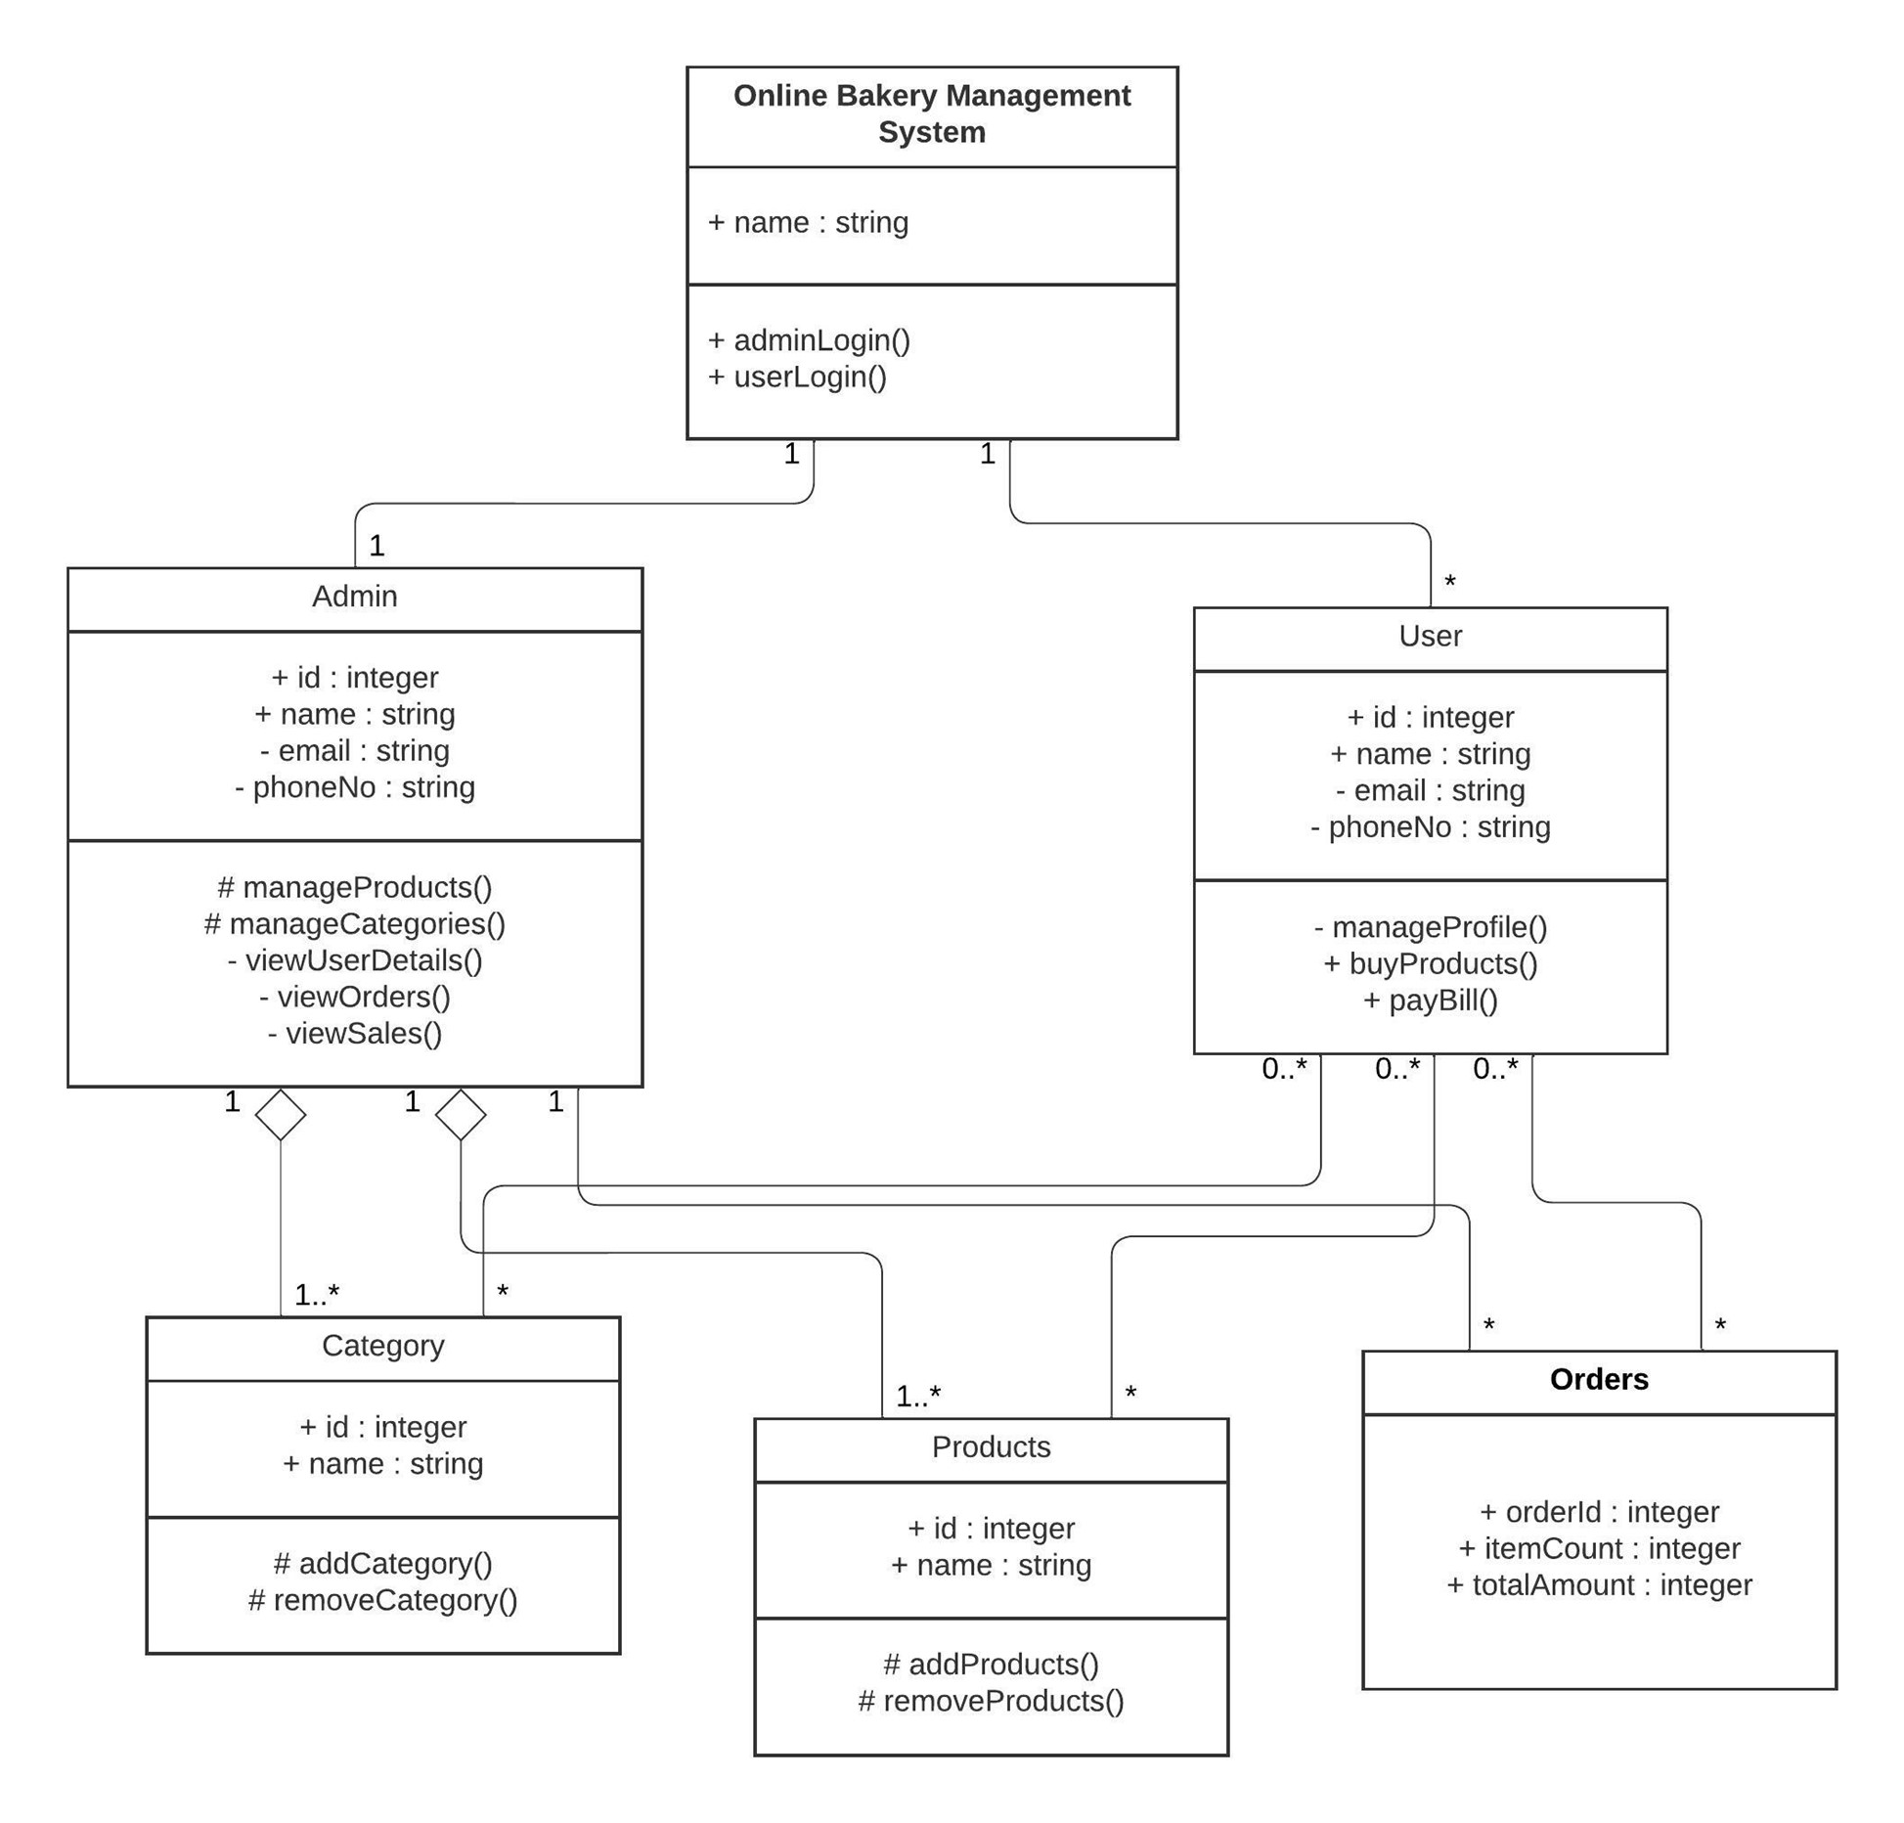
Class Diagram

Slide 13
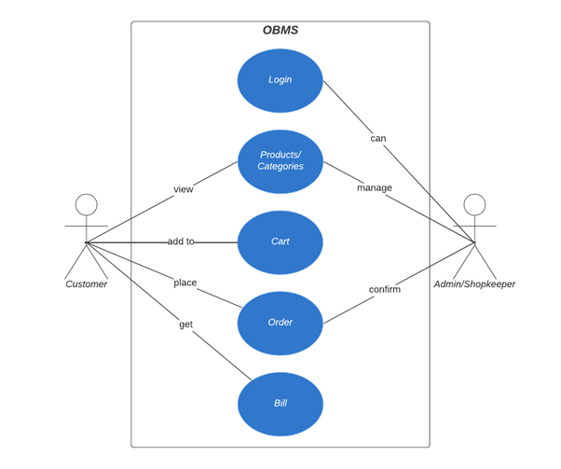
Use Case Diagram

Slide 14
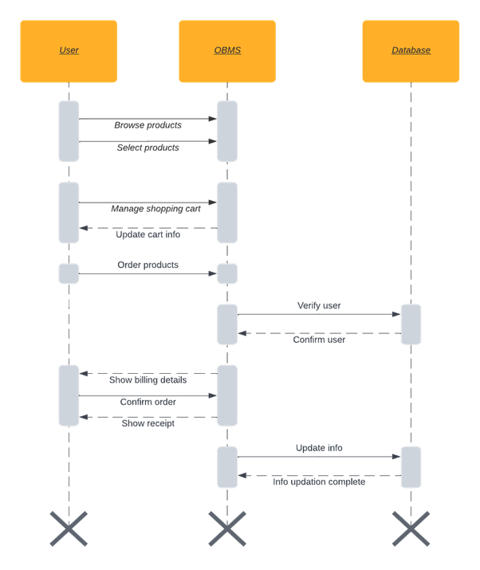
Sequence Diagram for User

Slide 15
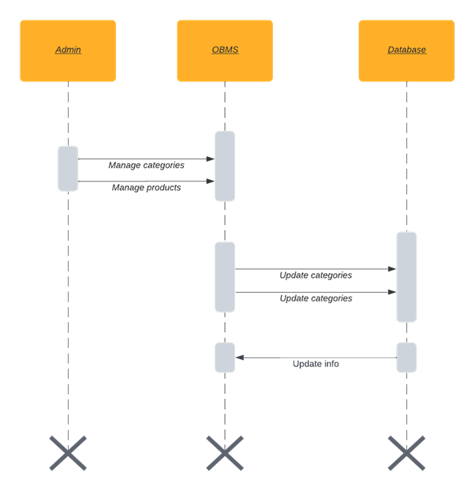
Sequence Diagram for Admin

Slide 16
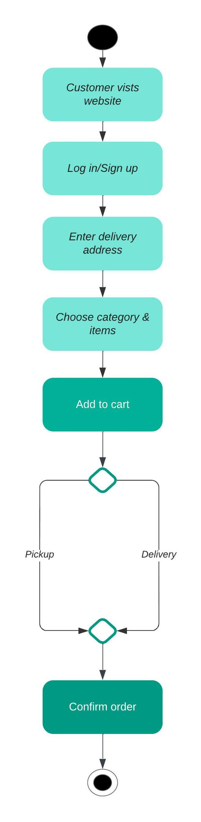
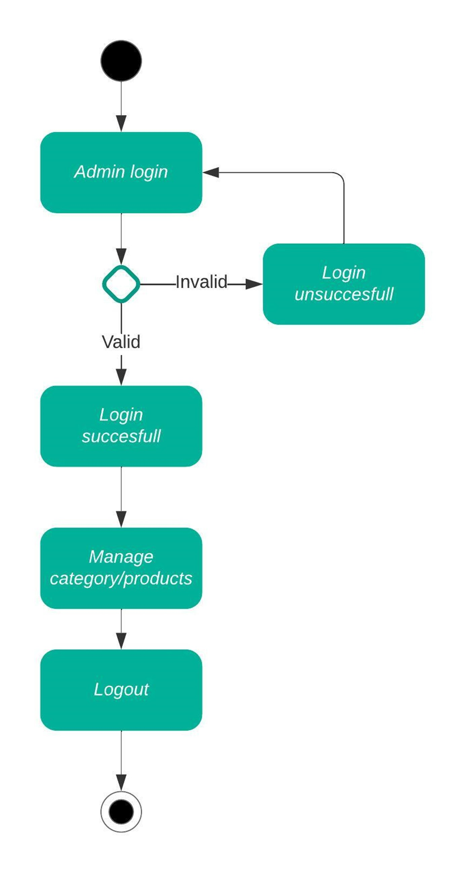
Activity Diagram for User
Activity Diagram for Admin

Slide 17
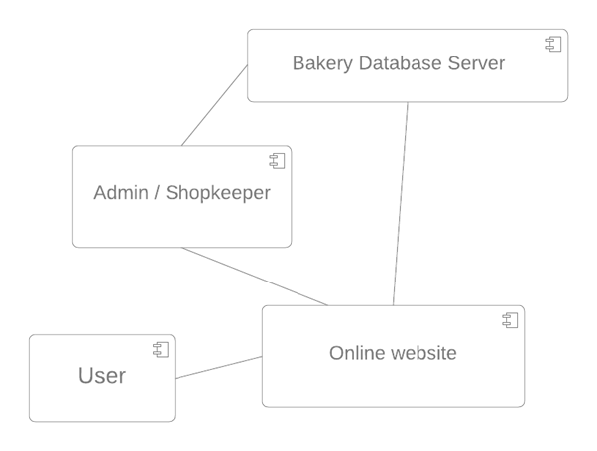
Component Diagram

Slide 18
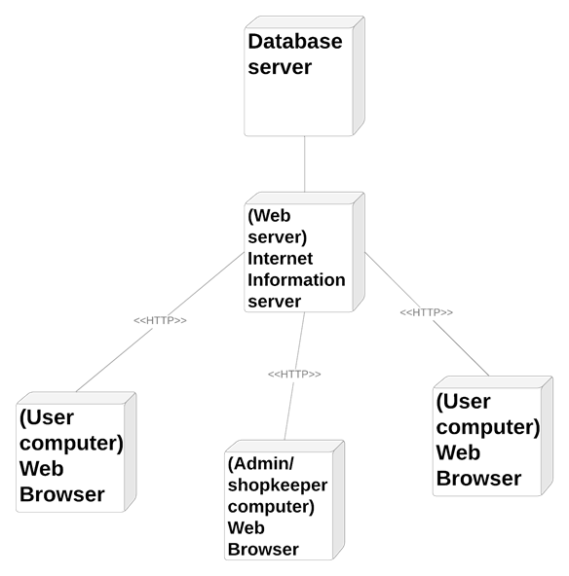
Deployment Diagram

Slide 19
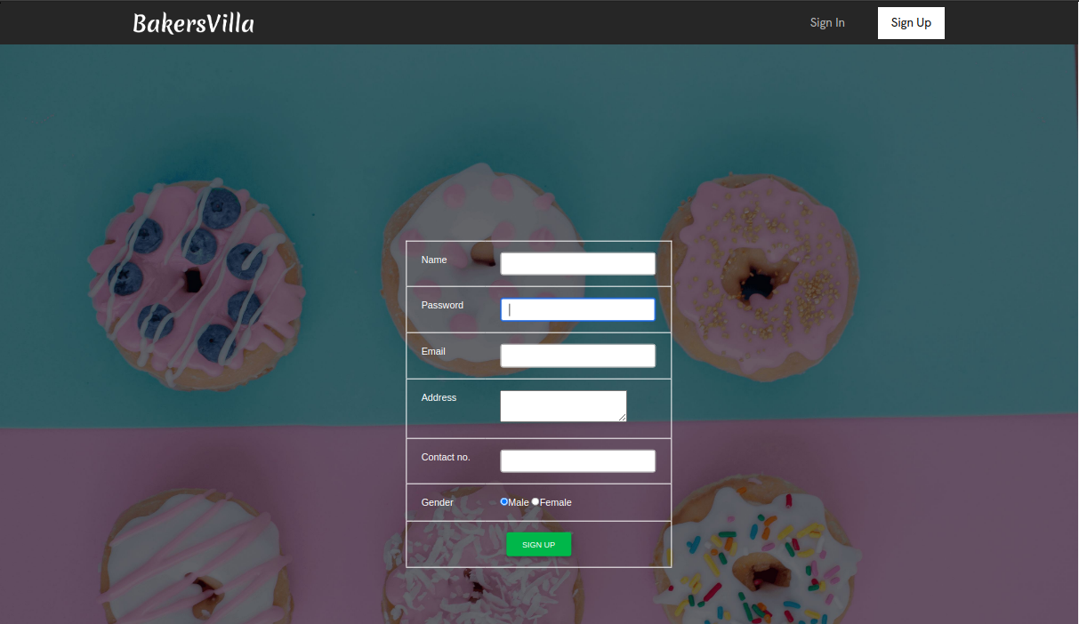
Registration Screen

Slide 20
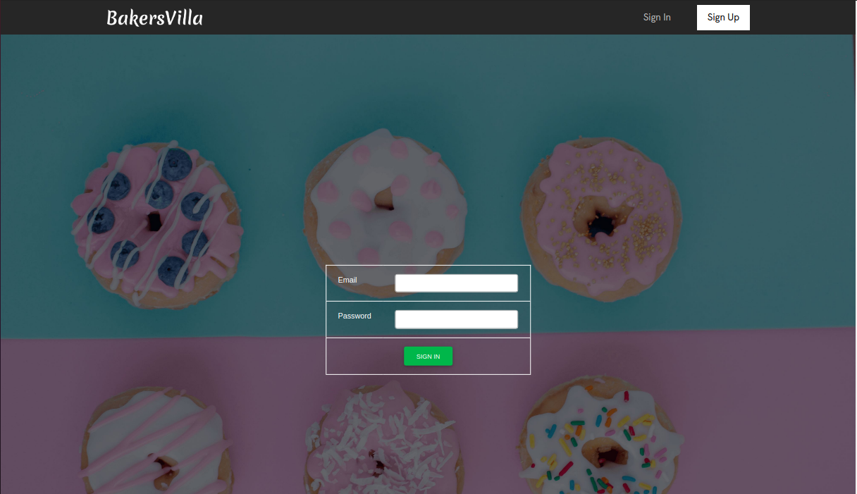
Login Screen

Slide 21
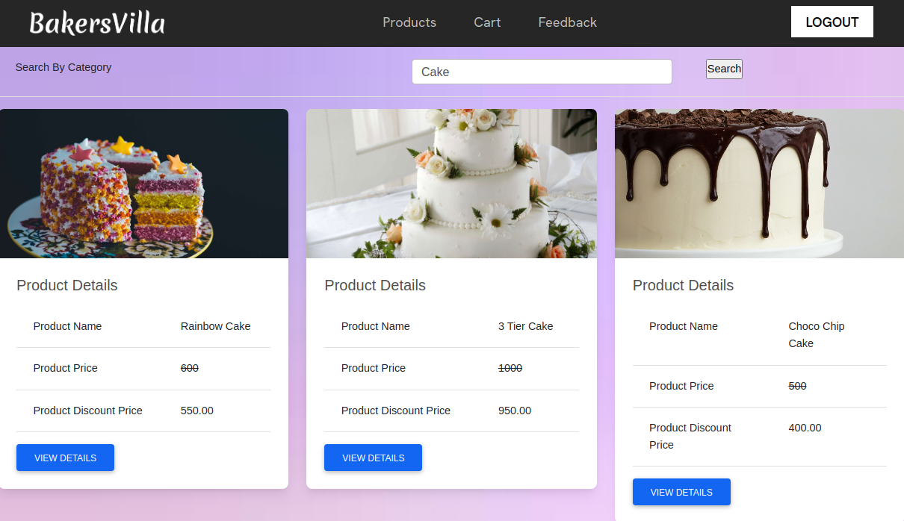
Product Screen

Slide 22
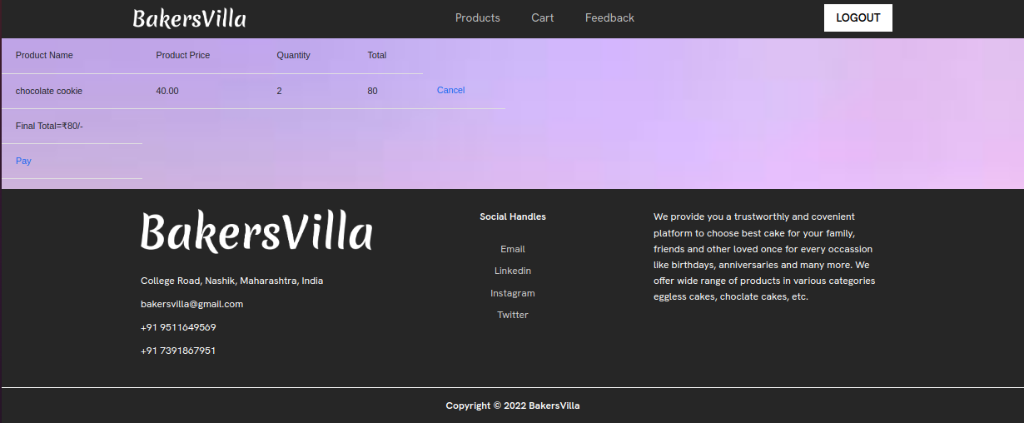
Cart Screen

Slide 23
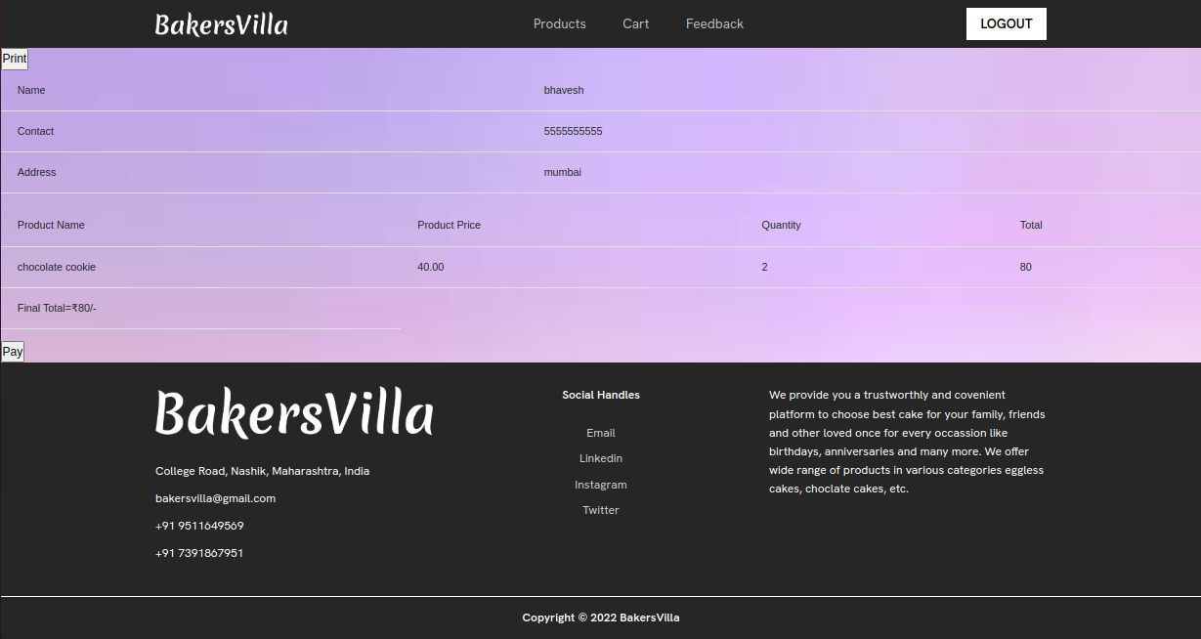
Bill Screen

Slide 24
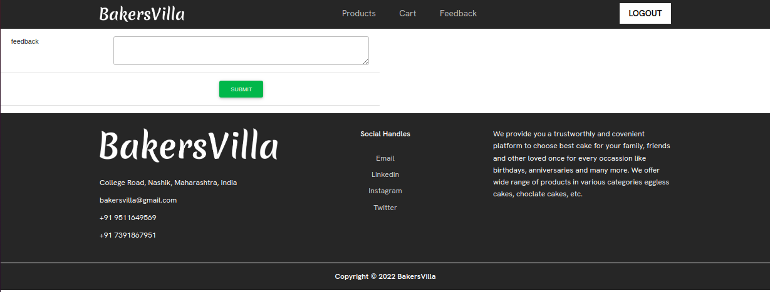
Feedback Screen

Slide 25
Advantages
It is fast, efficient and reliable.
Avoids data redundancy and inconsistency.
Very user friendly.
Easy accessibility of data.
Number of personal required is considerably less.
Provides more security and integrity to data.
Helps Bakery shops to automate bakery selling online.

Slide 26
Disadvantages
Requires training for the operator to maintain and look for statistical data.
Requires customer to have basic internet knowledge to traverse website with ease.
Different size and shapes product are not yet available, product lists are very rigid.
Only computer literate who may be able to use the information system and it can only through training that one can use the system.

Slide 27
Applications
This system can be used in single Bakery shops.
This system can be used to sell like chain of Bakery shops from a single site.
It's best to have a website for your bakery to make all the processes easy.
A simple web-based application platform for bakery shops that can help them to manage their stocks and day-to-day transaction with their customers.

Slide 28
Future Scope
Sellers can deal in a wide range of products. They can analyze customer buying patterns and preferences offers, discounts, and services.
Business can be easily scaled. By selling via online platforms, small traders and manufacturers get the seal of legitimacy.
Purchasing and selling products and services over the internet without the need of going physically to the market is what online shopping all about.
Can help Bakery shops to take cc payments.
Can provides email confirmation on payment success.

Slide 29
Conclusion
Human errors are reduced.
Data storage is done efficiently.
Data retrieval is faster.
Keeping a record of all entered was a very tedious job.
Searching a particular entry was tedious because it involved searching all entries which required more time.
The cost for maintenance is eliminated.
Makes system user friendly.
Our system provides two types of user administrator and local user which have a limited functionality. It improves the security.
Only the users who have administrative rights are allowed to create or modify users and unlock/lock users.

Slide 30
Bibliography
Books :
HTML & CSS: The complete Reference, fifth Edition Author: Thomas A. Powell First Published: 01 Jan 2010
Web Technologies - I Nirali Publication - By Dr. A. B. Nimbalkar
Web Technologies – II Vision Publication - By Kalpana Joshi & Rajinder Arora
Programming PHP - By Rasmus Lerdorf and Kevin Tatroe, O’Reilly publication
Software Engineering -R.V. Nikam
Websites :
www.php.net.in
www.W3school.com
https://www.tutorialrepublic.com/twitter-bootstrap-tutorial/bootstrap-grid-system.php
https://www.geeksforgeeks.org/
http://www.wikepedia.com
https://www.google.com

Slide 31
Thank you

